Slide 1

Neural Networks From Scratch
Hacker hour Presented by Diana Soltani
Notes:
Audience -> probably a lot of freshmen/sophomores
Minimal to no math to accommodate to the younger audience

Slide 2

Supervised learning
Supervisor as a teacher when learning:
“learning in which we teach or train the machine using data which is well labeled that means some data is already tagged with the correct answer”
Notes:
An example of supervised learning is spam filters.

Slide 3
Unsupervised learning
“Unsupervised learning is the training of machine using information that is neither classified nor labeled and allowing the algorithm to act on that information without guidance.”
Types of Algorithms Used
Clustering
Association
Notes:
Unsupervised learning classified into two categories of algorithms:
Clustering: A clustering problem is where you want to discover the inherent groupings in the data, such as grouping customers by purchasing behavior.
Association: An association rule learning problem is where you want to discover rules that describe large portions of your data, such as people that buy X also tend to buy Y.
An example of unsupervised learning is dota bots! If you guys ever play games such as League of Legends or Dota 2, you’ve probably heard of the “OpenAI Five” which is the name of a machine learning project that performs as a team of video game bots playing against human players in the competitive five-on-five video game Dota 2.

Slide 4
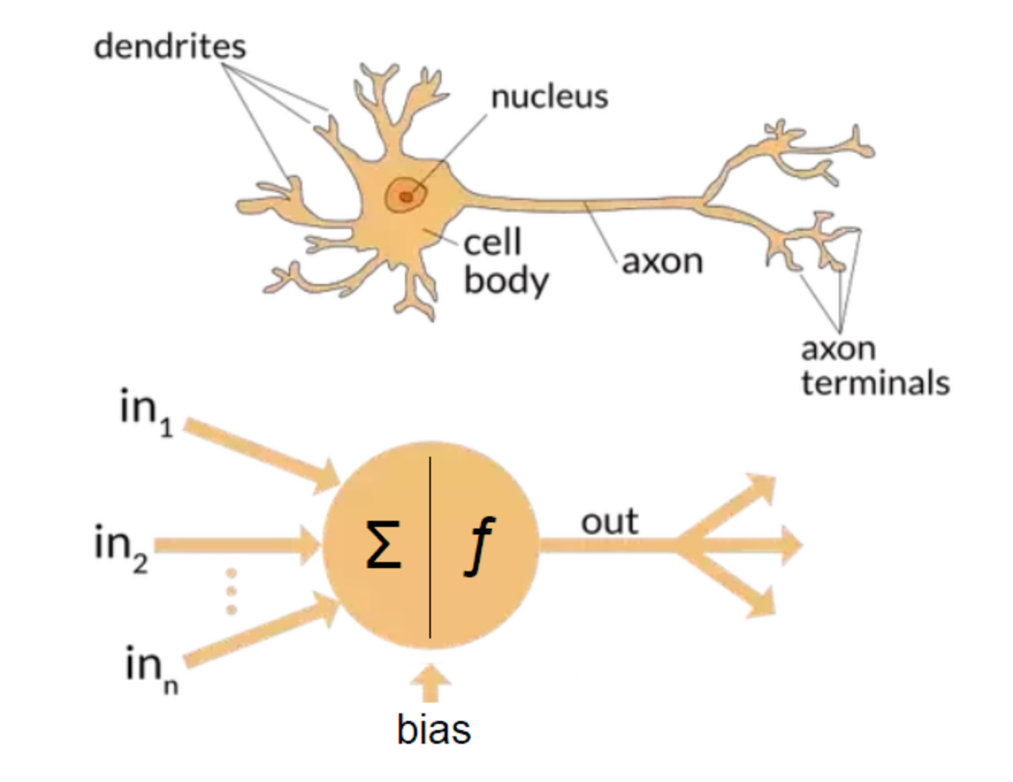
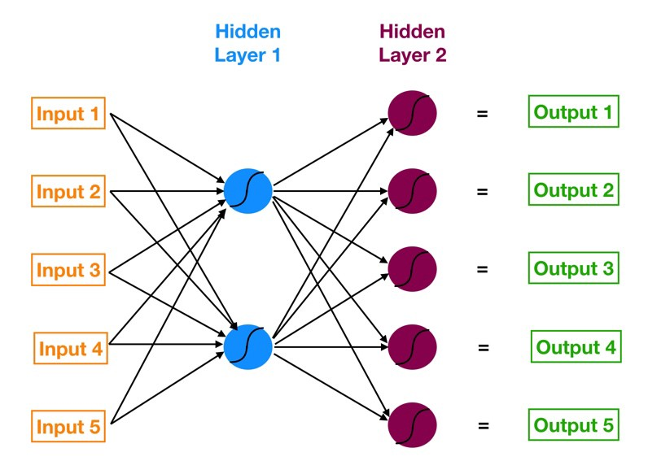
What is a neural network?
Notes:
Let’s recall some biology:
Signals are received from the dendrites
We send down these signals through the axon
The outgoing signal may then be used as another input for other neurons.
Definition: Neural networks are a set of algorithms that are loosely modeled after the human brain. These algorithms are set to recognize patterns by interpreting some form of data that can be understood by the computer.
(Hide the bio image) This is a more general structure for NN’s used today
Usually, a vector of features will be fed into the network. Then, a hidden (which could be several) layer takes in a set of weighted inputs to produce an output through an activation function. We’ll see this in more detail soon.

Slide 5

Essential components behind neural networks
Learning Rate
Activation Function
Regularization
Regularization Rate
Notes:
I will be going over these in the following slides.

Slide 6
Learning rate
Tuning parameter used when training a neural network
Affects how quickly our model can converge to a local minima
Notes:
Local minima just means the best accuracy.
We want our model to arrive at the best accuracy at a reasonable pace. In research and industry “less training time means lesser money spent on GPU cloud compute.”

Slide 7

Activation functions
Gives the output of a node given an input/set of inputs
Popular activation functions:
Sigmoid or Logistic
Tanh
ReLU (rectified linear units)
Step Function
Notes:
In artificial neural networks, the activation function of a node defines the output of that node given an input or set of inputs. A standard computer chip circuit can be seen as a digital network of activation functions that can be "ON" or "OFF", depending on input.
We’ll see an activation when working on our own neural network soon.

Slide 8
Regularization and regularization rate
Techniques used to reduce the error by fitting a function appropriately on the given training set and avoid overfitting.
Large weights in a neural network are a sign of a more complex network that has overfit the training data.
Penalizing a network based on the size of the network weights during training can reduce overfitting.

Slide 9
Working with data: Test, train, live model
Testing Data: a subset to test the trained model
Training Data: a subset to train a model
Notes:
We are ultimately using the same data set and splitting it into subsets.
Just make sure both subsets of the data is representative of the data set as a whole. Do not pick a test set with different characteristic than the training set.
Also, make sure your test set is large enough to yield statistically meaningful results.
Draw this on the board:
||||||||||||||||||||||||||||||||||||||||||||||||||XXXXXXXX
Training set Test set

Slide 10
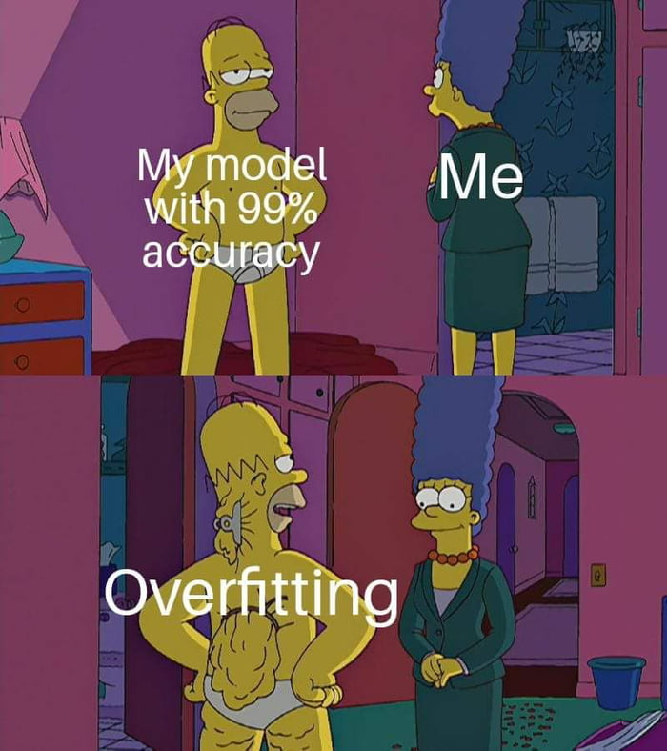
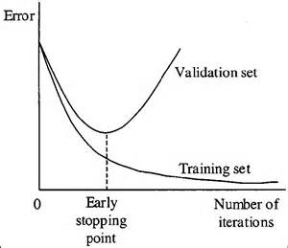
Overfitting (avoid!)
Model does not generalize well between training data and unseen data
How to avoid overfitting:
Cross-validation
Train with more data
Early stopping
Regularization
Notes:
Cross validation is a technique for evaluating ML models by training several ML models on subsets of the available input data and evaluating them on the complementary subset of the data.
Increasing the size of your data set should reduce spurious correlations and improve the performance of your learner.
[point to graph for early stopping. Minimize error]
Having regularization keeps the weights of your model at a manageable size.

Slide 11
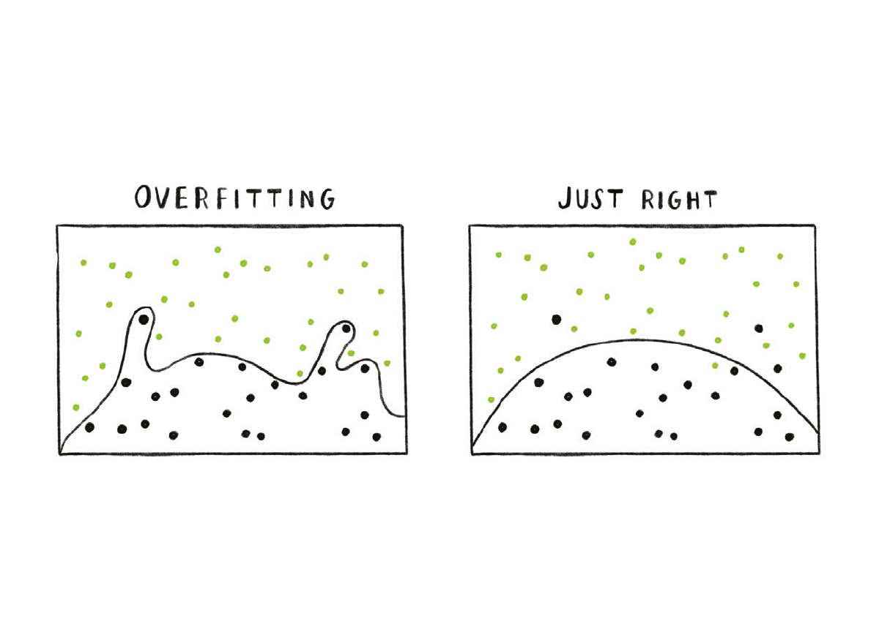
Notes:
Just another example of overfitting

Slide 12
Perceptrons
Inputs and data are assigned a discrete label between 0 and 1
We have a continuous output function to define the discrete values of the output

Slide 13
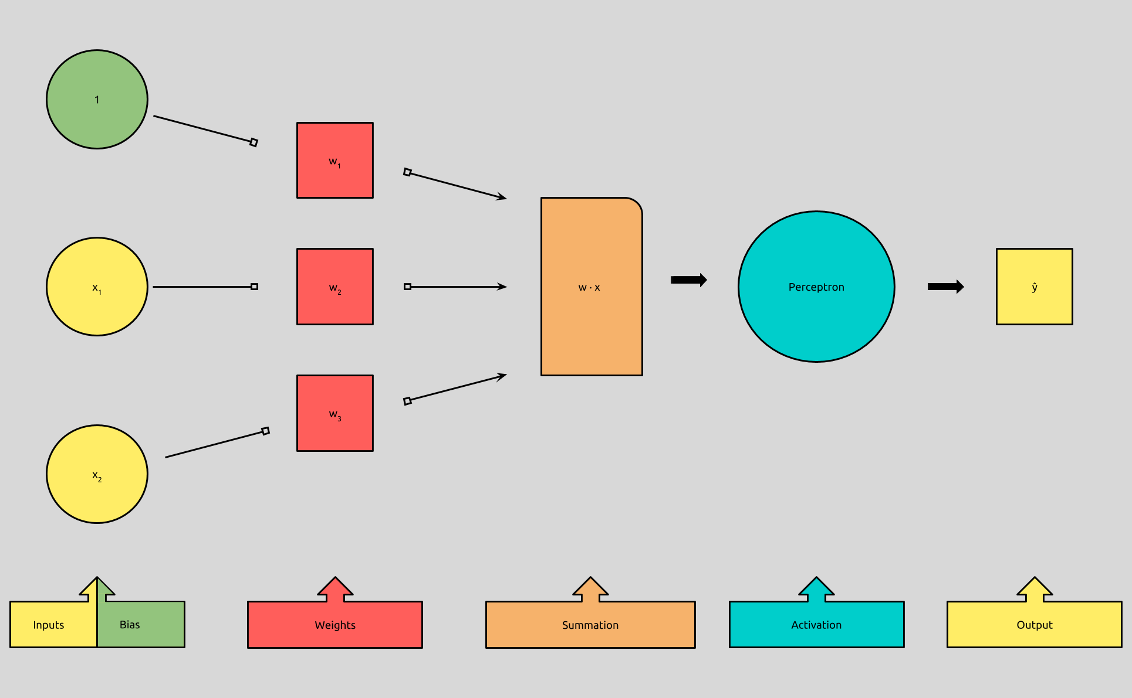
0.01
Notes:
From left to right:
We have inputs which is the data we are given. The bias, with the weight, affects the output
Let’s define weights– it can be considered as the parameter within a neural network that transforms the input data within the network’s hidden layers. We initialize our weight near 0 when we start. We’ll see this when we code a neural network.
Our perceptron assigns 1 if w*x > 0 and 0 otherwise as the activation function
Output is 0 or 1 as expected

Slide 14
Training a Perceptron
Initialize your initial weight vector (usually near 0) as an initial guess.
Choose some data point (x,y) in the Data set. Update parameters based on how poorly the model performs on the specific data point.
Repeat!
Notes:
Recall X is a vector of inputs, y is the output
* An underlined x means that it is a vector (an array of numbers)
[maybe draw a graph on the board here if time permits]
Given some data, if a linear separator exists, following these set of instructions will discover it. <- probably draw a line between the two

Slide 15

A perceptron coded from scratch with numpy

Slide 16
Thanks for Coming for the Pizza (and for learning about Neural Networks)!
Email me at diana.soltani@rutgers.edu for any questions!

Slide 17
Some references and material belong to Dr. Cowan, Machine Learning Crash Course, machinelearningmastery.com, and towardsdatascience.com

